Slide 1






Costa Rica
RPA & AI Hackathon
2023
By UiPath Community& Greenlight Consulting

Slide 2



Team Slide
DEVELOPERS:
Antonio Mora Blotta
Wilmer Diaz Amador
Marcos Chavarría Chacón
AGRICULTURAL EMPOWERMENT PLATFORM
PEA
“Knowledge and Fair Market”
Notes:
Please replace photograph with your team member by right click on image > change picture
Please add role and company name and add your email ID.
Feel free to remove extra picture and details if team size is smaller

Slide 3
Problem Statement & Proposed Solution
Solution
Problem Statement & Proposed Solution
To address the challenges faced by farmers, particularly micro and medium agricultural entrepreneurs, we have developed an Agricultural Empowerment Platform.
This solution was designed in collaboration with key industry experts and was based on a series of functional and non-functional requirements.
Key Features:
User Registration and Customizable Profiles.
Access to Price Information in Real Time.Search for Agricultural Job Offers.Educational resources.
Direct Connection with Buyers and Farmers.
Key Benefits:
Economic Empowerment.Transparency in the Supply Chain.
Sustainable development.
Strengthening Rural Communities.
Improving Food Security.
Agricultural Innovation.
The Agricultural Empowerment Platform represents a comprehensive solution that addresses the challenges faced by farmers, promoting sustainable agrodevelopment and improving the economic and social conditions of farming communities.
The farmer interacts with the Agricultural Empowerment Platform to access price information and use educational resources, thus contributing to agrodevelopment and the improvement of their economic situation.
In the agricultural community, farmers face economic difficulties due to lack of information about real market prices for their products.
Lack of access to up-to-date data and reliance on middlemen with opaque practices result in farmers receiving unfair payments for their crops.
This situation not only threatens their livelihoods, but also hinders agricultural development and undermines food security in the region.
Solving this problem is essential to improve the living conditions of farmers and strengthen the resilience of the agricultural sector in the community
Notes:
Problem: Please briefly mention what is the problem you are trying to solve / what is problem statement
Solution: What approach you took to solve the problem/ what is the solution / your solution to the problem

Slide 4
Benefits & Technologies Used
Benefits
Economic Empowerment: Farmers can negotiate fairly and receive adequate payment for their products, improving their economic situation.
Supply Chain Transparency: The platform promotes transparency by offering real-time pricing information, reducing opaque practices in the agricultural supply chain.
Sustainable Development: By receiving fairer incomes, farmers can invest in sustainable agricultural practices, which contributes to long-term development and environmental conservation.
Strengthening Rural Communities: Improves living conditions in agricultural communities, generating employment and stimulating local economic growth.
Improving Food Security: Contributes to regional food security by increasing the production and availability of fresh, quality food.
Agricultural Innovation: It can catalyze the adoption of advanced agricultural technologies to increase efficiency and productivity in the sector.
The Agricultural Empowerment Platform represents a comprehensive solution that addresses the challenges faced by farmers, promoting sustainable agrodevelopment and improving the economic and social conditions of farming communities.
Details
End-User | Small and medium production farmers
User Department | AGRICULTURAL
Industries | Agriculture and sales.
UiPath Products Used | UiPath Studio UiPath Document Understanding UiPath Integration Services UiPath Orchestatror UiPath Marketplace
Other – Integrations / APIs / Technologies Used | WHATSAPP, Open AI
Notes:
Details: Its always good to share details like who is the end-user of your solution, which department/industry will benefit and what technologies have been used.
Benefits: Please include key features / value proposition of your solution

Slide 5
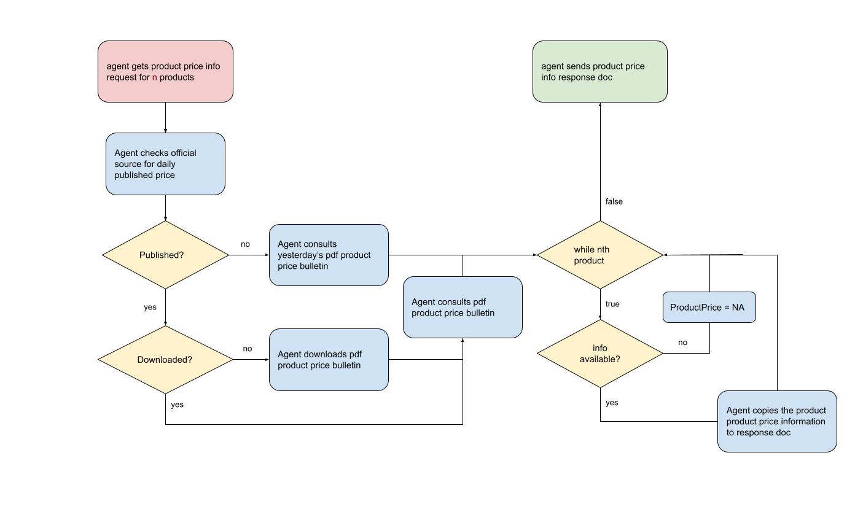
Solution Architecture
Process AS-IS
Notes:
You can remove the slide if you are not showing Solution Architecture

Slide 6
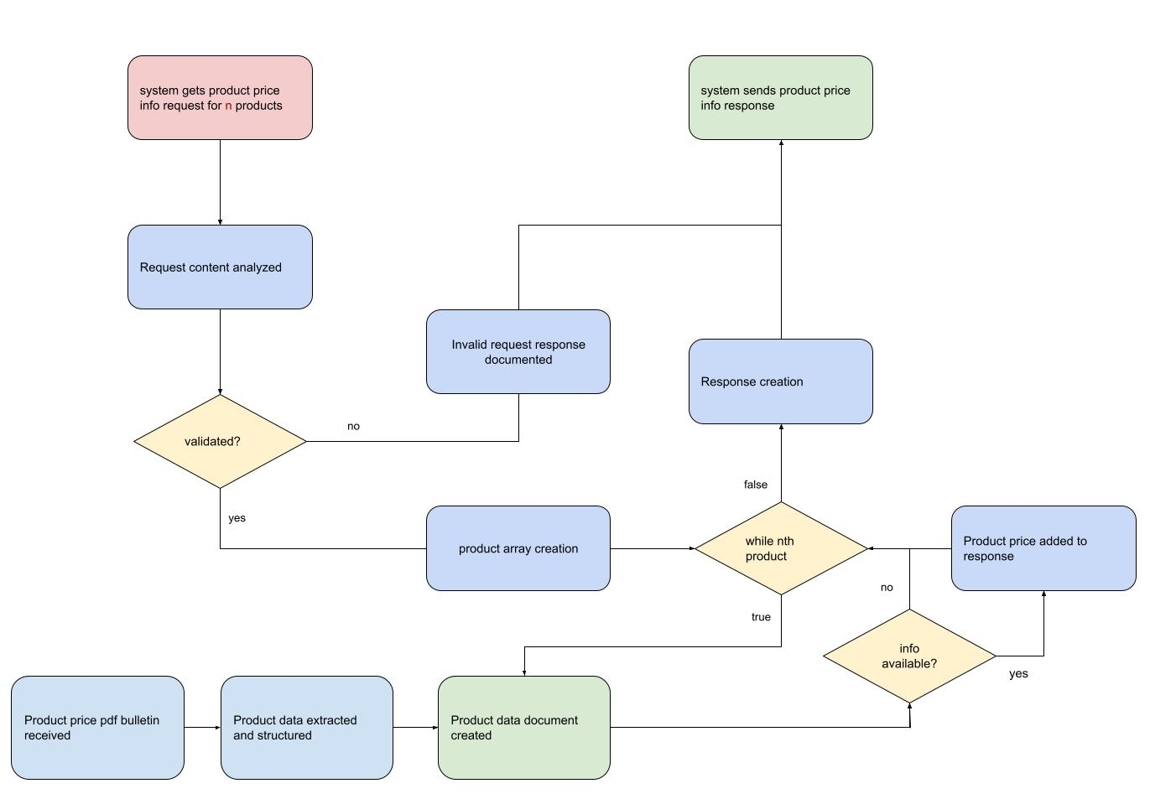
Process TO-BE

Slide 7


